Slide 1
An Environment for
Distributed Ontology Development
Based on Dependency Management
Eiichi Sunagawa, Kouji Kozaki, Yoshinobu Kitamura
and Riichiro Mizoguchi
The Institute of Scientific and Industrial Research,
Osaka University, Japan
Notes:
This is the outline of my talk.
First, as our purpose,
I will explain
what we mean by distributed ontology development in this research.
Next topic is a model and our system.
Here, I will show you the flow of our distributed development
and the overview of our system for it.
After that,
I will discuss some issues of distributed ontology development
and. show you how the system helps developers
to cope with the issues.
Finally, I will make a brief summary and talk about the future work.

Slide 2
Contents
Our Purpose
  what do we mean by distributed ontology development?
Model and our system
  the flow of distributed development
  the overview of our system for it
Issues and solutions
  issues of distributed ontology development
  how does our system help developers to cope with the issues?
Summary and Future Work
Notes:
This is the outline of my talk.
First, as our goal,
I will explain what we mean by distributed ontology development in this research.
Next topic is a computer model for it.
Here, I will show you the flow of our distributed development
and discuss 2 issues we have dealt with.
At the same time, I introduce systems supporting to cope with the issues.
After that, I will show you the implementation of our system.
Finally, I will make a brief summary and talk about the future work.

Slide 3
Our Purpose
Our Purpose
  To realize and support Distributed Ontology Development
  To develop a computer environment for it
Distributed Ontology Development
  An ontology can be divided into several component ontologies.
  Development of ontology as a whole is achieved by editing and modification of its component ontologies.
Notes:
Ok, first, I will set out our purpose.
In this research,
we aim to realize and support Distributed Ontology Development.
and to develop a computer environment for it.
So, before describing our system,
let me explain
what we mean by distributed ontology development in our research.
In general, an ontology can be divided into several component ontologies.
These component ontologies
are identified according to their conceptual level or domains.
For example,

Slide 4
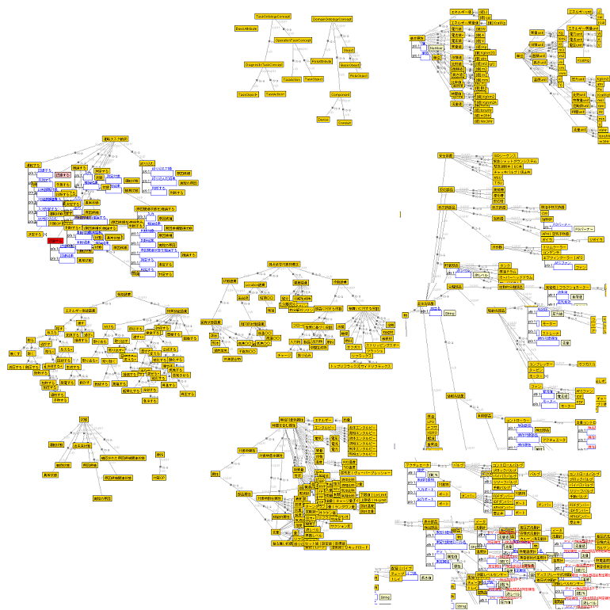
Example of divided ontology
～Oil Refinery Plant Ontology～
Oil Refinery Plant Ontology
Top Level
Ontology
Task
Ontology
Attribute
Ontology
Equipment
Ontology
Object
Ontology
Function
Ontology
Facility
Ontology
（ built in cooperation with NIPPON OIL Corp.）
Notes:
This is a part of the“Oil Refinery Plant Ontology”.
It was build by using “Hozo”,
which is our environment for ontology development.
Every yellow square defines one concept
and all these concepts forms Oil Plant Ontology.
If we focus our attention on a piece of this ontology,
we can
investigate several component ontologies of
attribute, equipment, function and so on.

Slide 5
Our Purpose & Goal
Our Purpose
  To realize and support Distributed Ontology Development
  To develop a computer environment for it
Distributed Ontology Development
  An ontology can be divided into several component ontologies.
  Development of ontology as a whole is achieved by editing and modification of its component ontologies.
Notes:
Like this, we can assume several component ontologies in one ontology.
Thus, in some case,
development of ontology as a whole is achieved by
editing and modification of its component ontologies individually.
We defined development of ontology in this manner
as Distributed Ontology Development.

Slide 6
Merits of Distributed Ontology Development
Cooperative Development
  Developers would divide target ontology and then they build component ontologies.
  They can also divide ontology before and during the course of construction.
Usage of each ontology as a component
  for reusing ontology as a part of another
  for exchanging a part of ontology
・・・
Notes:
Distributed ontology development applies to many kind of situations.
and it possesses many kind of merits.
First, it forms the basis of cooperative development.
For example,
developers would divide target ontology by roughly categorizing concepts,
and then they builds each component ontologies
in cooperation with other developers.
They can also divide it in such a manner
before and during the course of construction.
Second,
in this manner, an ontology can be used as a component.
Developers would reuse a partial ontology
as a part of another one.
And, they can exchange a part of ontology to another.
Third,
developers can see a hierarchy of partial ontologies.
It can be used as a map on construction of the ontology
such as listed here.

Slide 7



Distributed Ontology Development Process
Ontology Server
Shared space
(developers share a whole ontology)
Ontology Editor
Ontology Editor
Ontology Manager
Ontology Manager
update
Ontology Editor
Ontology Editor
Ontology Manager
Ontology Manager
Personal space
(Each developer builds and modifies his/her ontology individually)
Notes:
Now, let me explain how our distributed ontology development goes on.
This is our model of distributed ontology development process.
It is designed like a server-client system.
One is a shared space, where developers share the whole ontology.
All component ontologies are stored in Ontology Server.
and they are shared by each developer.
The other is a personal space,
where each developer builds and modifies
his or her own component ontology.
Each developer builds individually his or her own component ontology
by using Ontology Editor,
and open it to public by sending it to the shared space.
In doing so, the whole ontology is updated.
In addition,
component ontologies are connected with each other.
So, when shared ontologies are updated and changed,
every developer should pay attention to
whether that change influences his or her ontologies.
If so,
he or she has to modify his or her ontology
to cope with it.
This is a main issue in our research.
For this purpose,
Ontology Manager helps a developer in the following manner.
It downloads component ontologies from Ontology Server
and offers him or her the latest information.
Furthermore, if some component ontology is changed
and its influence is serious,
the system advises him or her to cope with it.
So, he or she modifies his or her ontology
and send it back again.
Every developer goes over this process
individually and in parallel.
Then the whole ontology is developed.

Slide 8

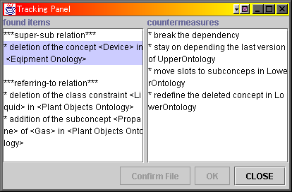
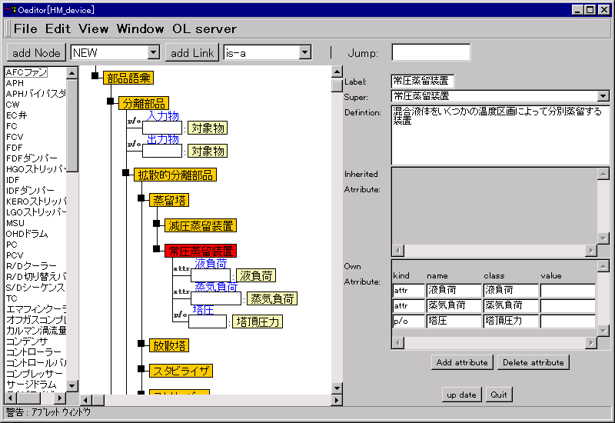
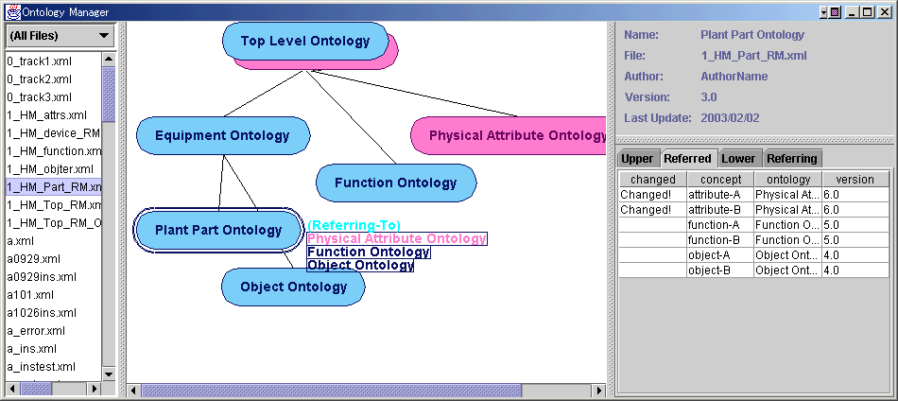

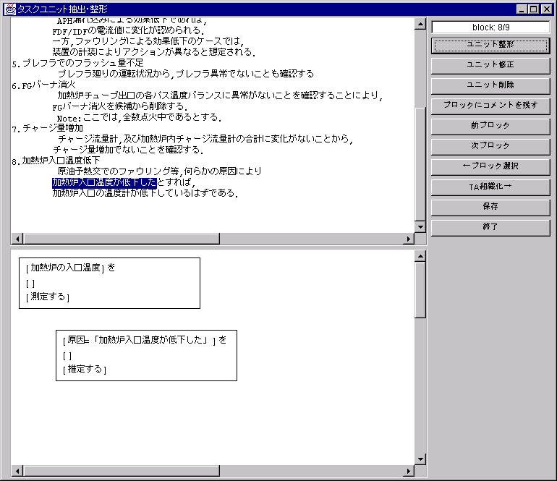

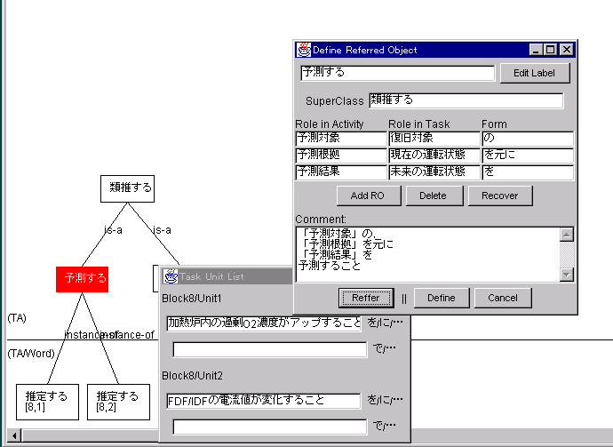
Ontology Development System “Hozo”
Information of changes /
Support modification
Ontology
Manager
Tracking
Panel
Ontology
Editor
browsing
Dependency
Management
building
（modifying）
Ontology Server
Ontology/Model Developer
Language Management System
Clients
(other agents)
Ontology
Reference / Install
support
Onto Studio
(a guide system for ontology design)
Model
Notes:
This is a total picture of our ontology building system.
It is named “Hozo”
and its principal feature
is to be based on fundamental ontological theories
such as “role-concept” and ”relation concept”.
Hozo is composed of “Onto-Studio”, “Ontology Editor”, “Ontology Server” and “Ontology Manager”.
Onto Studio is based on a method of building ontologies,
and it helps users
design an ontology from technical documents.
With this support, developers build ontology on Ontology Editor
and updates the ontology stored in Ontology Server.
In this manner,
distributed ontology development is realized in our system.
OK, next, I will discuss some issues of distributed development.

Slide 9
Issues of Distributed Development
Cooperative Work
making agreement
mutual understanding
thoroughness of a developmental standard
Integrated Management of Components
Areas we support especially on the basis of ontology development
specification of parts composition
avoidance of conflict between components
version control
information sharing
Access Control
Distributed Transparency
Notes:
For designing our system,
we investigated many kinds of issues
from the view point of the general distributed development.
These are its major issues.
There are at least four categories.
From top to down, Cooperative Work,
especially Computer Supported Cooperative Work,
Integrated Management of components,
Access control
and Distributed Transparency.
Each has sub issues shown in this slide.
CSCW issue is one of the hottest topics
in the research area of Human Computer Interaction.
Needless to say,
if developers can not communicate with each other well,
they never be able to develop a good ontology.
So this area has great worth of consideration.
However,
in our research, we don’t deal with it
because CSCW can be discussed
rather independently of the ontology development.
What makes our research unique
is management of dependency of component ontologies.
Integrated management of components
is the main area
we support especially on the basis of ontology development.
The others are connected with Access Control and Distributed Transparency. These are focused on system architecture.
From now on,
as the main theme of this presentation,
I will talk about
information sharing
and avoidance of conflict between components.
I will define these issues and
explain how the system helps to cope with them.

Slide 10
Main theme of this research
information sharing
avoidance of conflict between components
(based on “Dependency” between component ontologies)
Dependency: a relation between two ontologies, when some concepts in one ontology depend on concepts in other ontologies
Notes:
Information sharing and avoidance of conflict between components,
our system supports these 2 aspects
on the basis of dependency between component ontologies.
So, first,
let me explain what we mean by the dependency in our research.
When constructing an ontology,
concepts are usually defined
with reference to the definitions of other concepts.
In collaborative construction,
those referred concepts might exist
in another ontology developed by another person.
That means
some concepts in an ontology depend on other concepts in another ontology.
We defined 2 kinds of this relation
as the dependency between concepts.

Slide 11
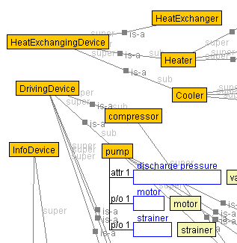
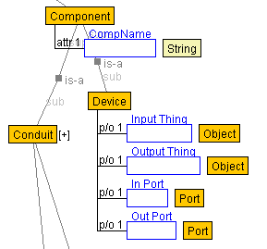
Dependency between ontologies 1:
Super-sub relation (is-a relation)
There are at least two concepts in is-a relation and each of the two concepts belongs to a different ontology of the two ontologies.
(Plant Facility Ontology)
(Equipment Ontology)
is-a relation
Super-sub relation
Upper ontology
Lower ontology
Notes:
One is Super-sub relation.
Two ontologies are said to be in this relation,
if and only if there are at least two concepts in is-a relation
and each of the two concepts belongs to a different ontology of the two.
We named these ontologies
"upper ontology" and "lower ontology" respectively.
The lower ontology depends on the upper one
at the point of inheriting definition.
For example, this shows a portion of “Oil Plant Ontology”.
There is is-a relation
between “Device” and each of the three classes:
“Heat Exchanging Device”, “Driving Device” and “Info Device”.
Then, we can define super-sub relation
between “Equipment Ontology” and “Plant Facility ontology”.

Slide 12
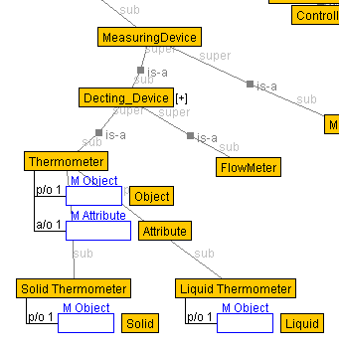
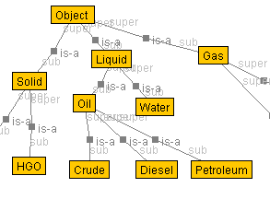
Dependency between ontologies 2:
Referring-to relation (class constraint)
A concept in one ontology refers to a concept in another as a class constraint.
(Plant Facility Ontology)
(Plant Object Ontology)
refer to as a class constraint
Referring-to relation
referred-to ontology
Referring ontology
Notes:
The other kind of dependency is Referring-to relation.
We define this relation
as the relation that a concept in an ontology refers
to a concept in another
as a class constraint.
We named the ontology containing the slot constrained
"referring ontology"
and the other "referred-to ontology".
For example,
“Liquid Thermometer” in “Plant Facility Ontology”
is referring to “Liquid” in “Object Ontology”
as a class constraint of “Object”.
Then,
we can define referring-to relation between these ontologies.

Slide 13
Information Sharing
Developers need to share the information about ontologies
Which ontologies are related to others
What the relations are
Who the developers of the related ontologies are
・・・

Slide 14
the interface of Ontology Manager
Component
ontologies
Ontology
Information
Panel
Super-sub relation
Ontology
List
Dependency
Panel
Ontology Viewer
Notes:
When developers edit their ontologies,
they need to share the information of ontologies.
For example, which ontologies are related to theirs,
what their relations are,
Who is the developer of the related ontologies, and so on.
To support this,
we designed a tool, named “Ontology Manager”.
It downloads the latest versions of ontologies
from Ontology Server.
Then, it shows developers a series of information
through these 4 panels.
Ontology Viewer and Dependency Panel
are especially important among them.
Ontology Viewer shows dependencies between ontologies graphically
by using nodes and links.
On this panel,
developers can grasp easily
the total picture of their target ontology
and can select an ontology to edit.
More details of dependencies
are displayed on “Dependency Panel”.
It shows the list of ontologies
which have a dependency with the selected ontology.
They are classified by their types
such as “upper ontology”, “referring ontology” and so on.

Slide 15
Main theme of this research
information sharing
avoidance of conflict between components
(based on “Dependency” between Ontologies)
Dependency: a relation between two ontologies,
when some concepts in one ontology depend on other concepts in another
Notes:
This is the system for information sharing.
I have explained relations between ontologies
and shown the tool
for sharing information about a set of ontologies.
The next topic is avoidance of conflict between ontologies.
In our model,
this issue is associated with consistency of ontologies.

Slide 16
Avoidance of conflict between components
Keeping consistency of each component
Problem:
  When editing an ontology, developers should pay attention to the influence of the change on other ontologies.
  In some cases, a change may destroy the consistency between ontologies.
Solution:
  approaches for keeping consistency of ontologies
    To restrict the change which influences on others
      (On Influencing Side)
    To modify the influenced ontology according to the type of the change
      (On Influenced Side)
influence
depend
Notes:
When editing an ontology,
we should pay attention to the influence of the change on other ontologies,
because each component ontology is connected with others through its dependencies.
So, in some cases, a change may destroy the consistency between ontologies.
As a solution of this problem,
there are two approaches to keep consistency of the dependency.
One is to restrict the change which influences on others.
Such a proactive restriction warns developers of a potential trigger of inconsistency.
The other solution is to modify the influenced ontology according to the type of the change.
In other words, the influenced ontology goes with the changed new ontology.
Then, it takes counter measures against its influence.
In our research, we take the latter approach.
To do this,

Slide 17
Keeping consistency from the influenced ontology
5 kinds of countermeasures taken in the influenced ontology for keeping consistency of the dependency
accept
consistency
broken
To modify influenced ontology
①
change
Subject to the type of the change
②
To leave the influenced ontology
kept
③
To modify influenced ontology
in order to reduce the influence
reject
To stay compliant with the last
version of the changed ontology
Available in all type of the change
④
⑤
To break the dependency and
import concepts it depends on
Notes:
We devised 5 kinds of countermeasures
to keep the consistency between ontologies.
First, they are divided into two types
according to whether the change is accepted or rejected.
When developers make agreement and accept the change,
then, they check whether the consistency of the dependency.
If it is broken, they have to modify the influenced ontology.
But, if it has been kept,
they can leave it as it is. So, no countermeasure in such a case.
And, when the developers rejects the change,
they choose suitable one from those 3.
One is to modify the influenced ontology against the change
and to reduce the influence.
Second
is to stay compliant with the last version of the changed ontology
under version control.
This method is to temporarily avoid unacceptable ontology.
The last is to break the dependency.
The influenced ontology imports the necessary concepts
from the depending ontology
and break the dependency between the two.
Counter measures from 1 to 3
are subjected to the type of the change.
The rest 2 countermeasures
are available to all types of the change.
So, let us investigate the types of the change.

Slide 18
Types of the changes
In super-sub relation
Operation on a concept
  Deletion a concept
  Addition a sub concept
Change of the definition
  Change of the label (name)
  Deletion of a slot
  Addition of a slot
  Change of the class constraint (inheriting)
    Generalizing
    Specializing
    Change to a completely different concept
  Change of the class constraint (overridden)
    Generalizing
    Specializing
    Change to a completely different concept
In referring-to relation
Operation on a concept
  Deletion of a concept
  Addition of a sub concept
Change of the definition
  Change of the label (name)
  Deletion of a slot
  Deletion of a slot
  Addition of a slot
17 types of the change
are considered
We identified the possible way
of modification
to keep the consistency
Notes:
For each kind of dependency,
we can find two major kinds of patterns of the change:
operation on the concept itself and changing its definition.
In all, we have 17 types of the change of the concept
according to the kind of dependency.
And, for the influence of each pattern,
we identified the possible way of modification
to keep the dependency.
So, next,
we applied 5 kinds of countermeasures to each case of the change.

Slide 19
Countermeasures against the influencing changes
Types of the change | Countermeasures to keep the consistency
 | Accept the change |  | Reject the change
 | Modify | Leave | Modify | last version | Break the dependency
Super-sub relation
Operation of a concept
Deletion of a concept | ２ | NA | １ | １ | １
Addition of a sub concept | ２ | １ | NA | １ | １
Change of a definition
Change of a label | １ | １ | NA | １ | １
・・・
Referring-to relation
Operation of a concept
Deletion of a concept | １ | NA | １ | １ | １
Addition of a sub concept | １ | １ | NA | １ | １
Change of a definition
Change of a label | １ | １ | NA | １ | １
・・・
Add the same as deleted class and define a new super-sub relation
① add the same as deleted slot to a depending concept
② delete all influenced concepts
Notes:
As a result, we’ve come up with this table.
This shows whether 5 kinds of countermeasures
are available or not,
and how many they are supported
for each type of the change listed in the last slide.
The influenced ontology is modified based on this framework.
Here, I’ll show you an example of modification of ontology.
Assume deletion of a concept in Super-sub relation,
that is, there are two ontologies and two concepts in each ontologies are connected in is-a relation, and
a developer of the upper ontology deletes the concept
which is depended by the lower ontology.
To cope with such a change,
The system provides 5 countermeasures according to this table.
And the developer of the influenced lower ontology
can select suitable one.
The First is the method to accept the change.
Then, we have 2 countermeasures
for the modification of the lower depending ontology.
One is
to add the same as deleted slot
to a depending concept in the lower ontology.
I will skip the other countermeasures,
because of the time limitation.
Like this,
we investigated the possible countermeasures for each type of change
and summarized the result in this table.
This is a method for keeping the consistency of the dependency.
Now, let me show you
how to modify the influenced ontology in our system
and a tool for supporting it within this framework.

Slide 20
Support to modify ontology
Ontology
Viewer
Ontology
Information
Panel
Ontology
List
Changed
ontology
Dependency
Panel
Notes:
The First step of the modification
is information service on Ontology Manager.
Assume the following situation.
Someone has deleted the concept in the super-sub relation
from the upper ontology.
like an example in the last slide.
And after that,
a developer of the lower ontology logs in this system
and runs Ontology Manager.
Then,
it downloads a set of component ontologies,
and checks them.
In this case,
it finds the upper ontology is changed
and influences the lower ontology,
So,
Ontology Manager notifies the developer of the lower ontology
that the influence may break consistency of its dependencies.
It is shown on Ontology Viewer by color-shift of changed ontology.
and which concept is deleted is shown on Dependency Panel.
So, he or she knows necessity of modification
for keeping the consistency of ontologies.

Slide 21
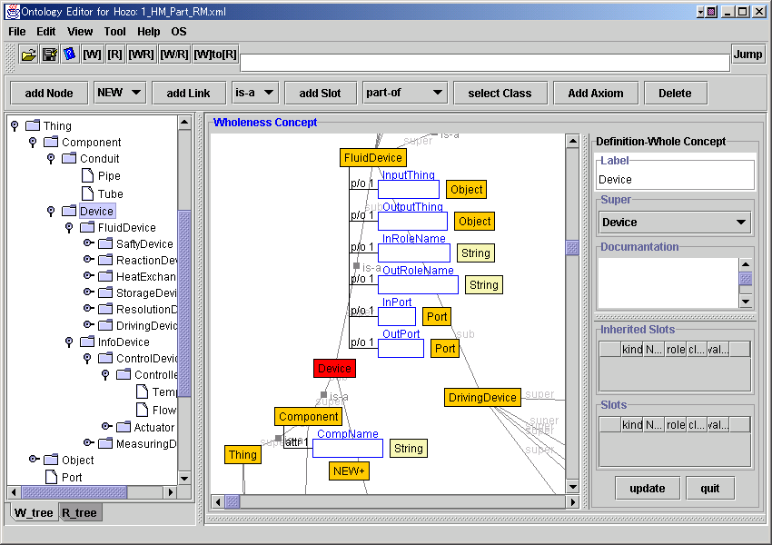
“Tracking Panel”
- the tool for the modification of the influenced ontology -
the change of the influencing ontology
the possible countermeasures
Tracking
Panel
Ontology
Editor
Notes:
Next, to keep the consistency of dependency,
the developer of lower ontology
should get more information
that how the influencing ontology has been changed
and what countermeasures are supported.
These are shown in the panel, named "Tracking Panel".
This tool is contained in Ontology Editor.
To begin with,
the developer opens the influenced lower ontology
on Ontology Editor
and use “Tracking Panel”.
This panel lists the change of the influencing ontology
and the possible countermeasures
for coping with each change.
He or she selects
the change of the ontology and the countermeasure for it.
Then his or her ontology
is modified semi automatically
and the consistency of dependency is recovered.
After this, he or she can go on building
of the lower ontology normally.
This is a sequence of the modification
for keeping the consistency of ontology.

Slide 22
Related Work
Concurrent Version System
  It is hard to understand the difference between versions of source code.
  Ontology description languages are stylized and well-structured.
OntoEdit
  It controls developers’ access to target ontology exclusively.
  Our system cntrols their access by each component ontologies.
KAON
  It applies the strategies to one ontology.
  We applies it to several ontologies for distributed development.
Notes:
Now, I mention some related work.
Concurrent Version System has the architecture very similar to our system.
It is often used for distributed software development.
In general, it is hard to understand
the difference between versions of source code
because there are many coding styles.
In contrast,
ontology description languages are stylized and well-structured.
So, the system can detect the change of ontology
and identify its influence.
Onto Edit is a noted tool for collaborative development.
In order to keep its consistency,
that system control s their access to a target ontology exclusively.
On the other hand,
our system control s their access by every component ontologies.
The Karlsruhe Ontology and Semantic Web framework
has developed a system which resembles to ours
in the way of looking at
a change of ontology and strategies to keep its consistency.
The main difference between KAON and us
is the model as a situation.
They apply their strategies to evolution of one ontology.
On the other hand,
we apply our strategies to several distributed ontologies.
But I believe their works can be also applied to distributed development.

Slide 23
Summary and future work
Distributed ontology development
  Its process
  Its issues and solutions
  How our system realizes it
Future work
  Keeping the consistency from the influencing ontology
  Consistency of the whole ontology and version control
  Construction of component ontologies
  and so on
Notes:
Now, let me summarize my talk.
First, I have shown the model of distributed ontology development.
Then, in order to solve its issues,
we have presented 2 systems based on dependency between ontologies.
One is used to share the information of ontologies among developers.
The other is to modify ontology
for keeping its consistency.
I have proposed an environment to help distributed ontology development.
To advance distributed ontology development,
we have some issues as future work.
They are
keeping the consistency from the influencing ontology.
consistency of the target ontology and version control.
Construction of component ontologies
and so on..
I guess, that’s all I wanted to say today.
Thank you very much for your attention.

Slide 24
Thank you.

Slide 25
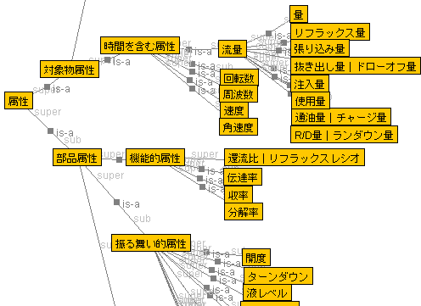
Data Structure of Dependency in Ontology
・The name and the version of depended ontology
・a copy data of the definition of the concept it depends on
in the depended Ontology
Header
Header
Data part
Data part
Inheriting Definitions
Constraining classes
“Depended Side”
Upper（Referred）Ontology
Depend
“Depending Side”
Lower（Referring） Ontology
Notes:
★おそらく時間が足りなくなると思うので，話の流れからはこのスライドはカットして，
変化をどうやって検出するかの質問が出たときに使うようにするつもりです．
下記の文章は，論文からの転用そのままです．
To manage the dependencies, the system manages the information about each component ontology as follows:
Its name, its version, its developer and the last update time of itself
the name and the version of ontologies it depends on
a copy data of the definition of the concept it depends on in other ontology
When a developer edits a component ontology,
Ontology Editor accesses other component ontologies it depends on and compiles them temporarily.
At this phase, a concept hierarchy is built up as an ontology (e.g. inheritance of the definition).
When he/she quits editing, Ontology Editor distinguishes concepts from its affiliation
and saves concept which the user has edited with information about its dependency as the last version of the ontology.

Slide 26
How to manage the dependency between ontologies
There is a dependency between ontologies A and B
Ontology A
Ontology B
is-a relation
or
refers to as
a class constraint
Concept a
Concept b
At the implementation level
Ontology A
Ontology B
is-a relation
or
refers to as
a class constraint
Concept a
Concept a
Concept b
make the copy of definition of the concept it depends on
Notes:
Here, I show How to manage the dependency between ontologies in our system.
When there is a dependency between ontologies A and B, like this.
At the implementation level ontology B has a copy of definition of the concept it depends on in it.

Slide 27
Check the consistency and how the concept has been changed
Ontology A
Ontology B
making the copy
inheriting the definition
class constraint
Concept B
Concept A
Concept A
“Concept A” has been changed
Ontology A
Ontology B
Comparison
inheriting the definition
class constraint
Concept A’
Concept A
Concept B

